Slide 1

Zeroth Presentation of Project on
“SMART WHEELCHAIR AND HOME AUTOMATION FOR PARALYZED”
Presented by
24. JASIRA T P
34. NAYANA RAMESHAN
46. SHRAVAN SREEDEEP
48. SOORYA P
under the guidance of
Dr. C SREEKUMAR
DEPARTMENT OF ELECTRICAL & ELECTRONICS ENGINEERING
GOVT. COLLEGE OF ENGINEERING KANNUR- 670563
Oct 2021

Slide 2


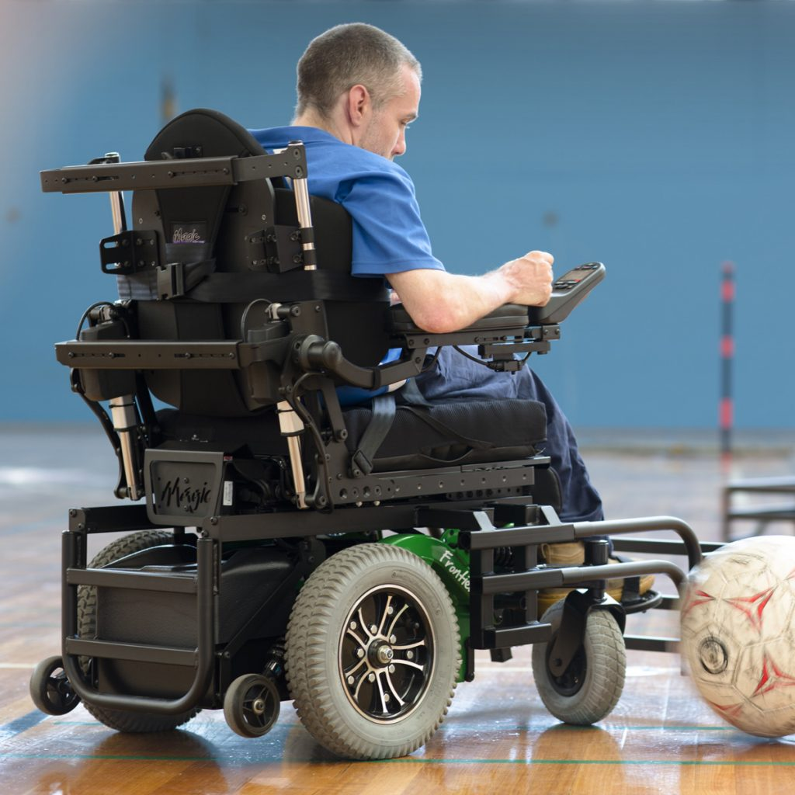
PROJECT AREA
Internet of Things
Machine Learning
Mobility Aids and Equipment's

Slide 3
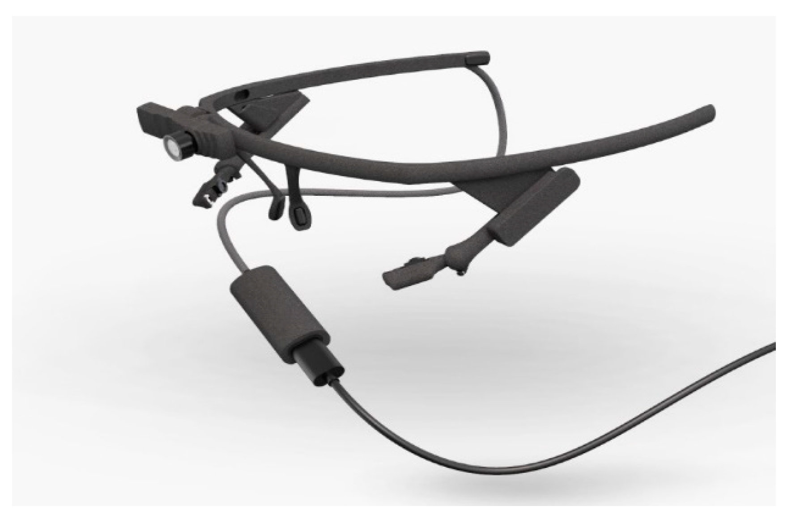
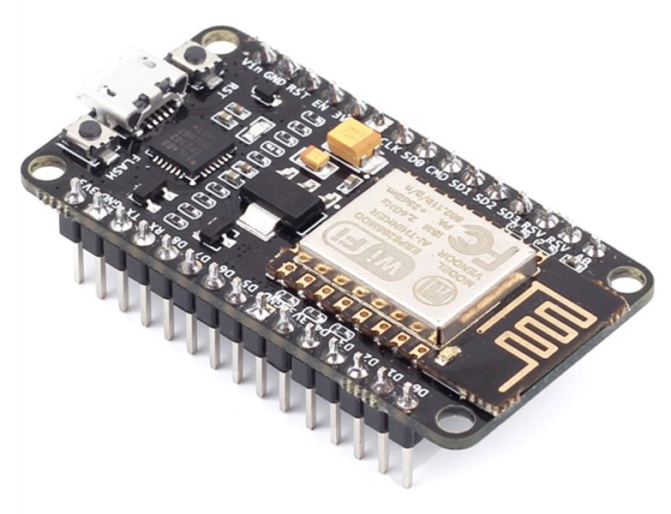
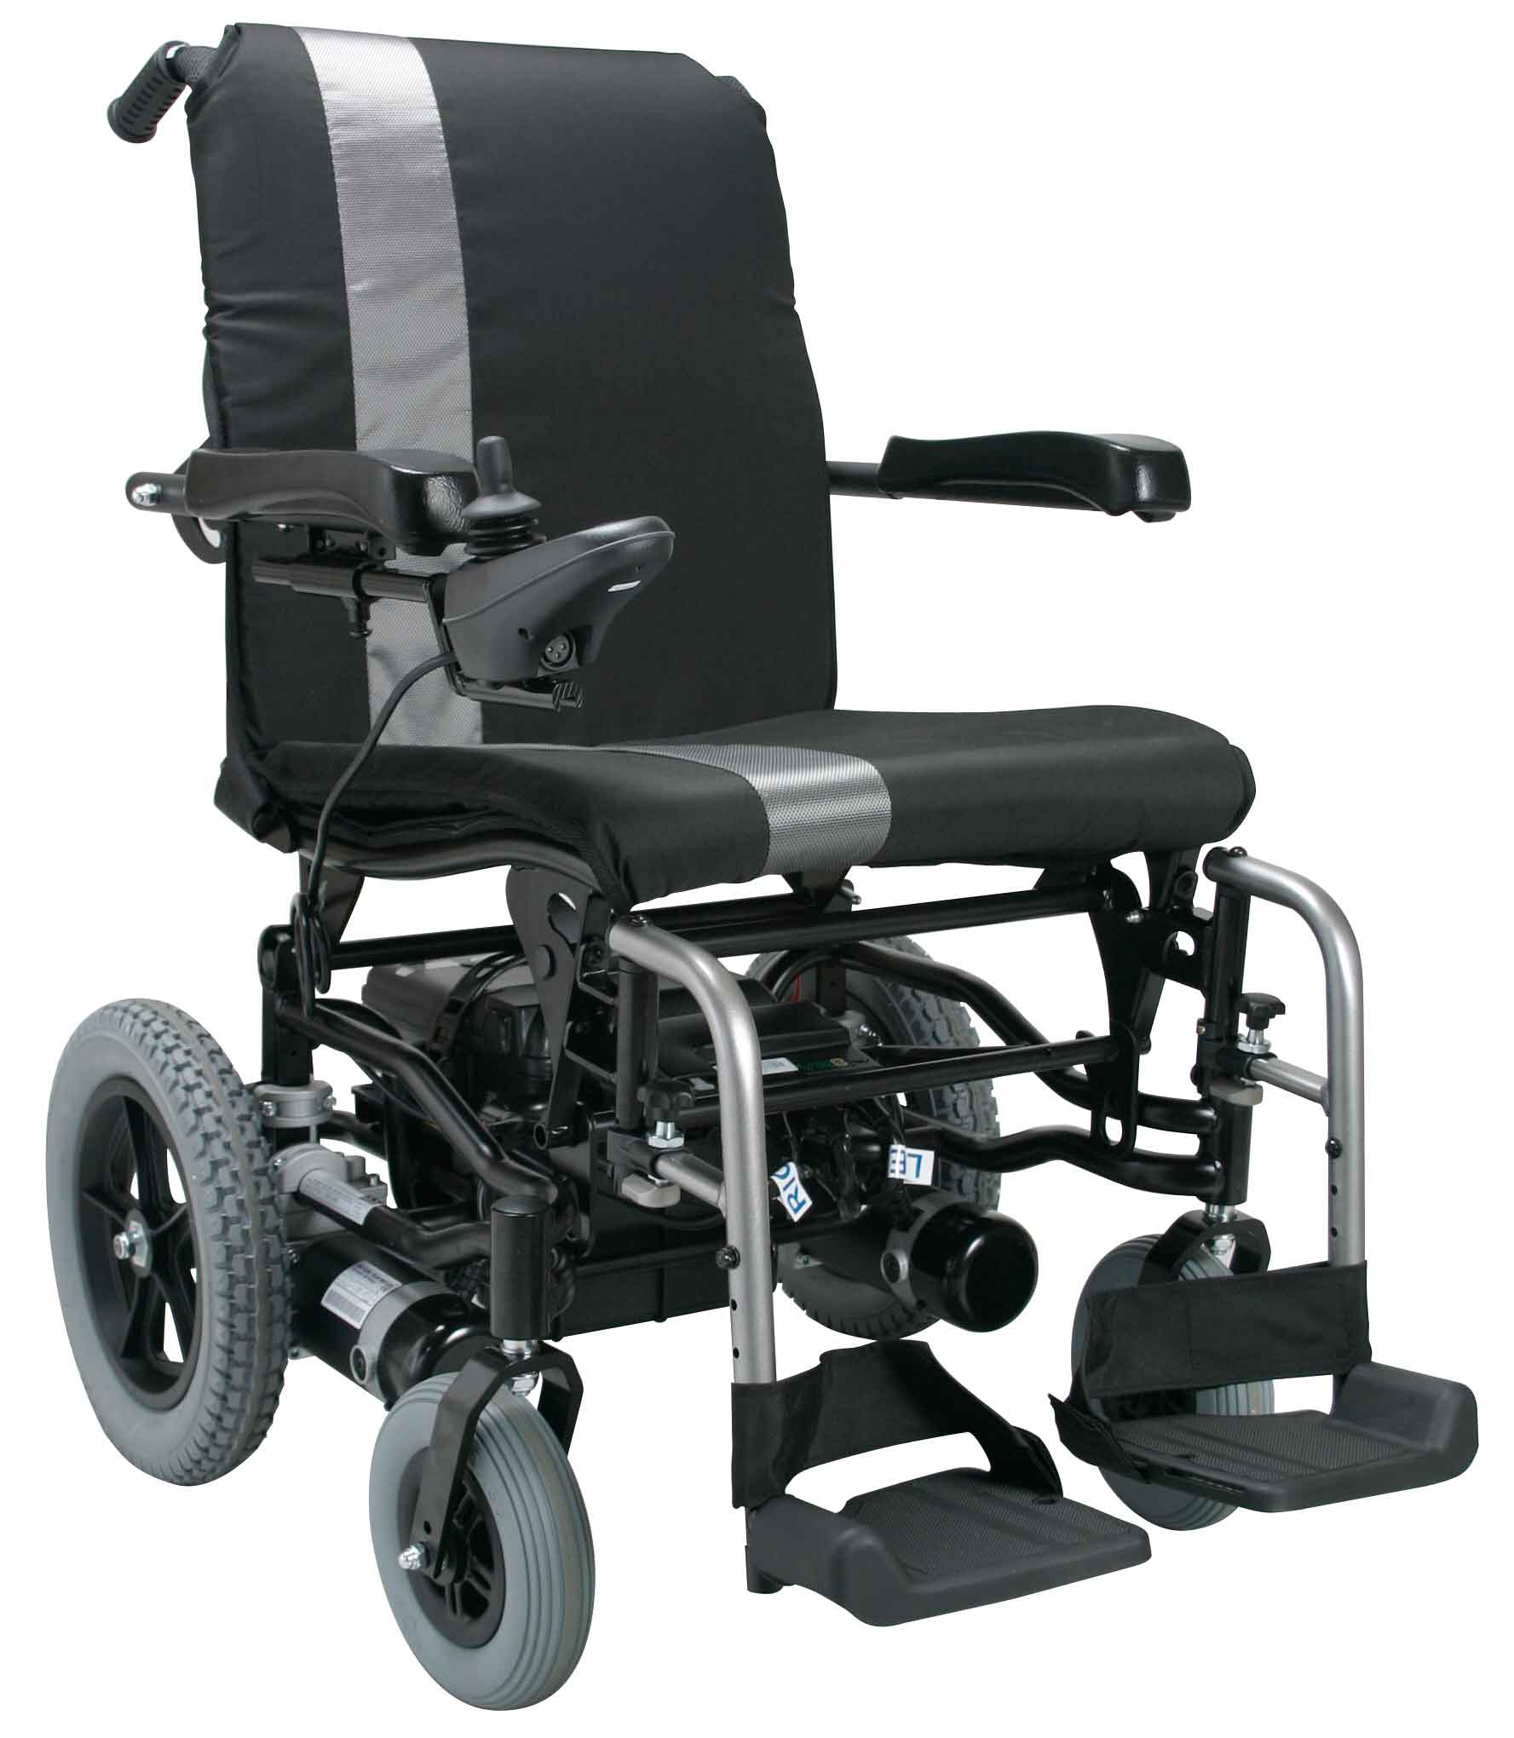
OBJECTIVES
To track eye movement and control basic devices like bulb, fan etc.
To design and implement an autonomous electric wheelchair.
To control the electric wheel chair by tracking eye movements.

Slide 4
MOTIVATION
Paralyzed stroke patients are unable to normally communicate with their environment. For these patients, the only part of their body that is under their control, in terms of muscular movement, is their eyeballs.
The biggest problem that paralyzed patients face is leading their own life without anyone else's help. This includes basic day to day operations like switching on basic devices like fan, bulb etc.

Slide 5
OVERVIEW
Our project is to make an automated working prototype of a smart wheel chair and home automation system that can be controlled by eye tracking.
The prototype shall be designed for paralysed people with only motor functions for eye movement.
We are also considering on making aware of surrounding obstructions and make decisions accordingly.

Slide 6
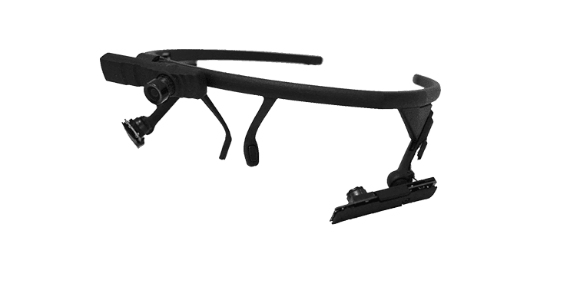
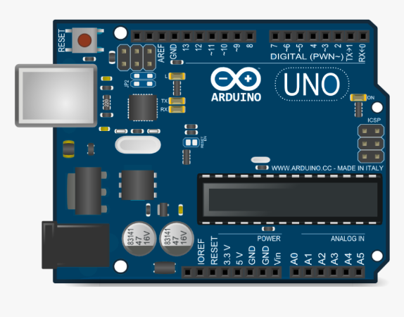
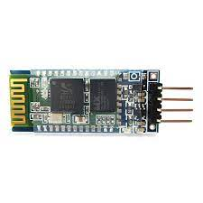
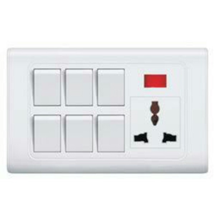
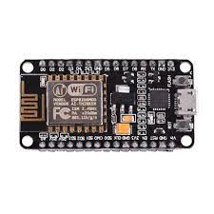
BLOCK DIAGRAM
MATLAB USER GRAPHICAL INTERFACE
MATLAB CODE
CAMERA MODULE
ELECTRIC WHEEL CHAIR
MATLAB BLUETOOTH TRANSMISSION CODE
BLUETOOTH MODULE
ARDUINO UNO
NODE MCU

Slide 7
Camera module captures the eyeball movement.
Pre trained model identifies the position of the pupil.
Transmission of position to microcontroller through Bluetooth module.
Selection of mode (Wheelchair / Home appliance)by microcontroller.
Movement of wheel chair based on position of eyeball in wheelchair mode.
Control of home appliances with Node MCU and relay circuits in home appliance mode.

Slide 8
WORK PLAN
Program and train machine learning model for eye tracking. (7th semester)
Design and simulation of the circuit for autonomous wheelchair. (7th semester)
Design and simulation of the circuit for home automation. (7th semester)
Interface the eye tracker, home automation and wheelchair together. (7th semester)
Fabrication and implementation of home automation circuit. (8th semester)
Hardware implementation of eye tracking glasses. (8th semester)
Test and solve real time issues. (8th semester)
Hardware implementation of autonomous wheel chair. (8th semester)

Slide 9
CHALLENGES
The system needs a PC to track eye movement and pass commands all the time.
We are considering on making the model run on a cloud platform or using Raspberry Pi micro controller instead of Arduino for better computing power.
Detection of eye movement in dim areas.
The camera can be used to capture IR images after removing the IR filter in its lens. Then by using an IR led it is possible to image the eyeball even in dim lights.

Slide 10
REFERENCE
Ahmad F. Klaib1, Nawaf O. Alsrehin1, Wasen Y. Melhem2, Haneen O. Bashtawi2, Aws A. Magableh1. “Eye Tracking Algorithms, Techniques, Tools, and Applications with an Emphasis on Machine Learning and Internet of Things Technologies”, September 2020
Mohammed Saifuddin Munna1, Juliana Shetara2, Shantanu Bhattacharjee3, Md. Zahed Hossain Bhuiyan4, “Design & Implementation of a Mind Controlled Home Automation System”, January 2017
Pramodini A. Punde, Dr. Mukti E. Jadhav, Dr. Ramesh R. Manza, “A study of Eye Tracking Technology and its applications”, 2017 IEEE
Tan Kian Hou, Yagasena and Chelladurai“Arduino based voice controlled wheelchair”, 2020

Slide 11
THANK YOU

